Slide 1

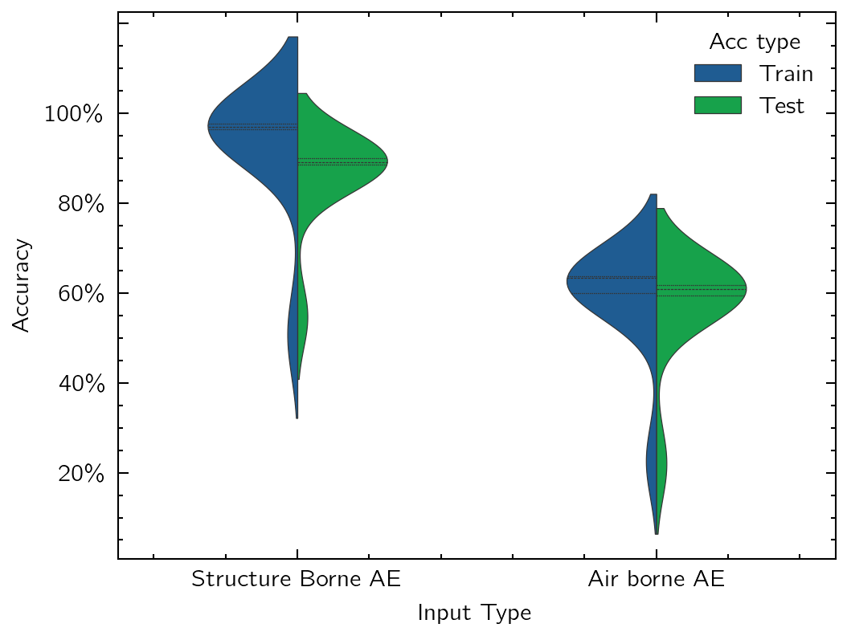
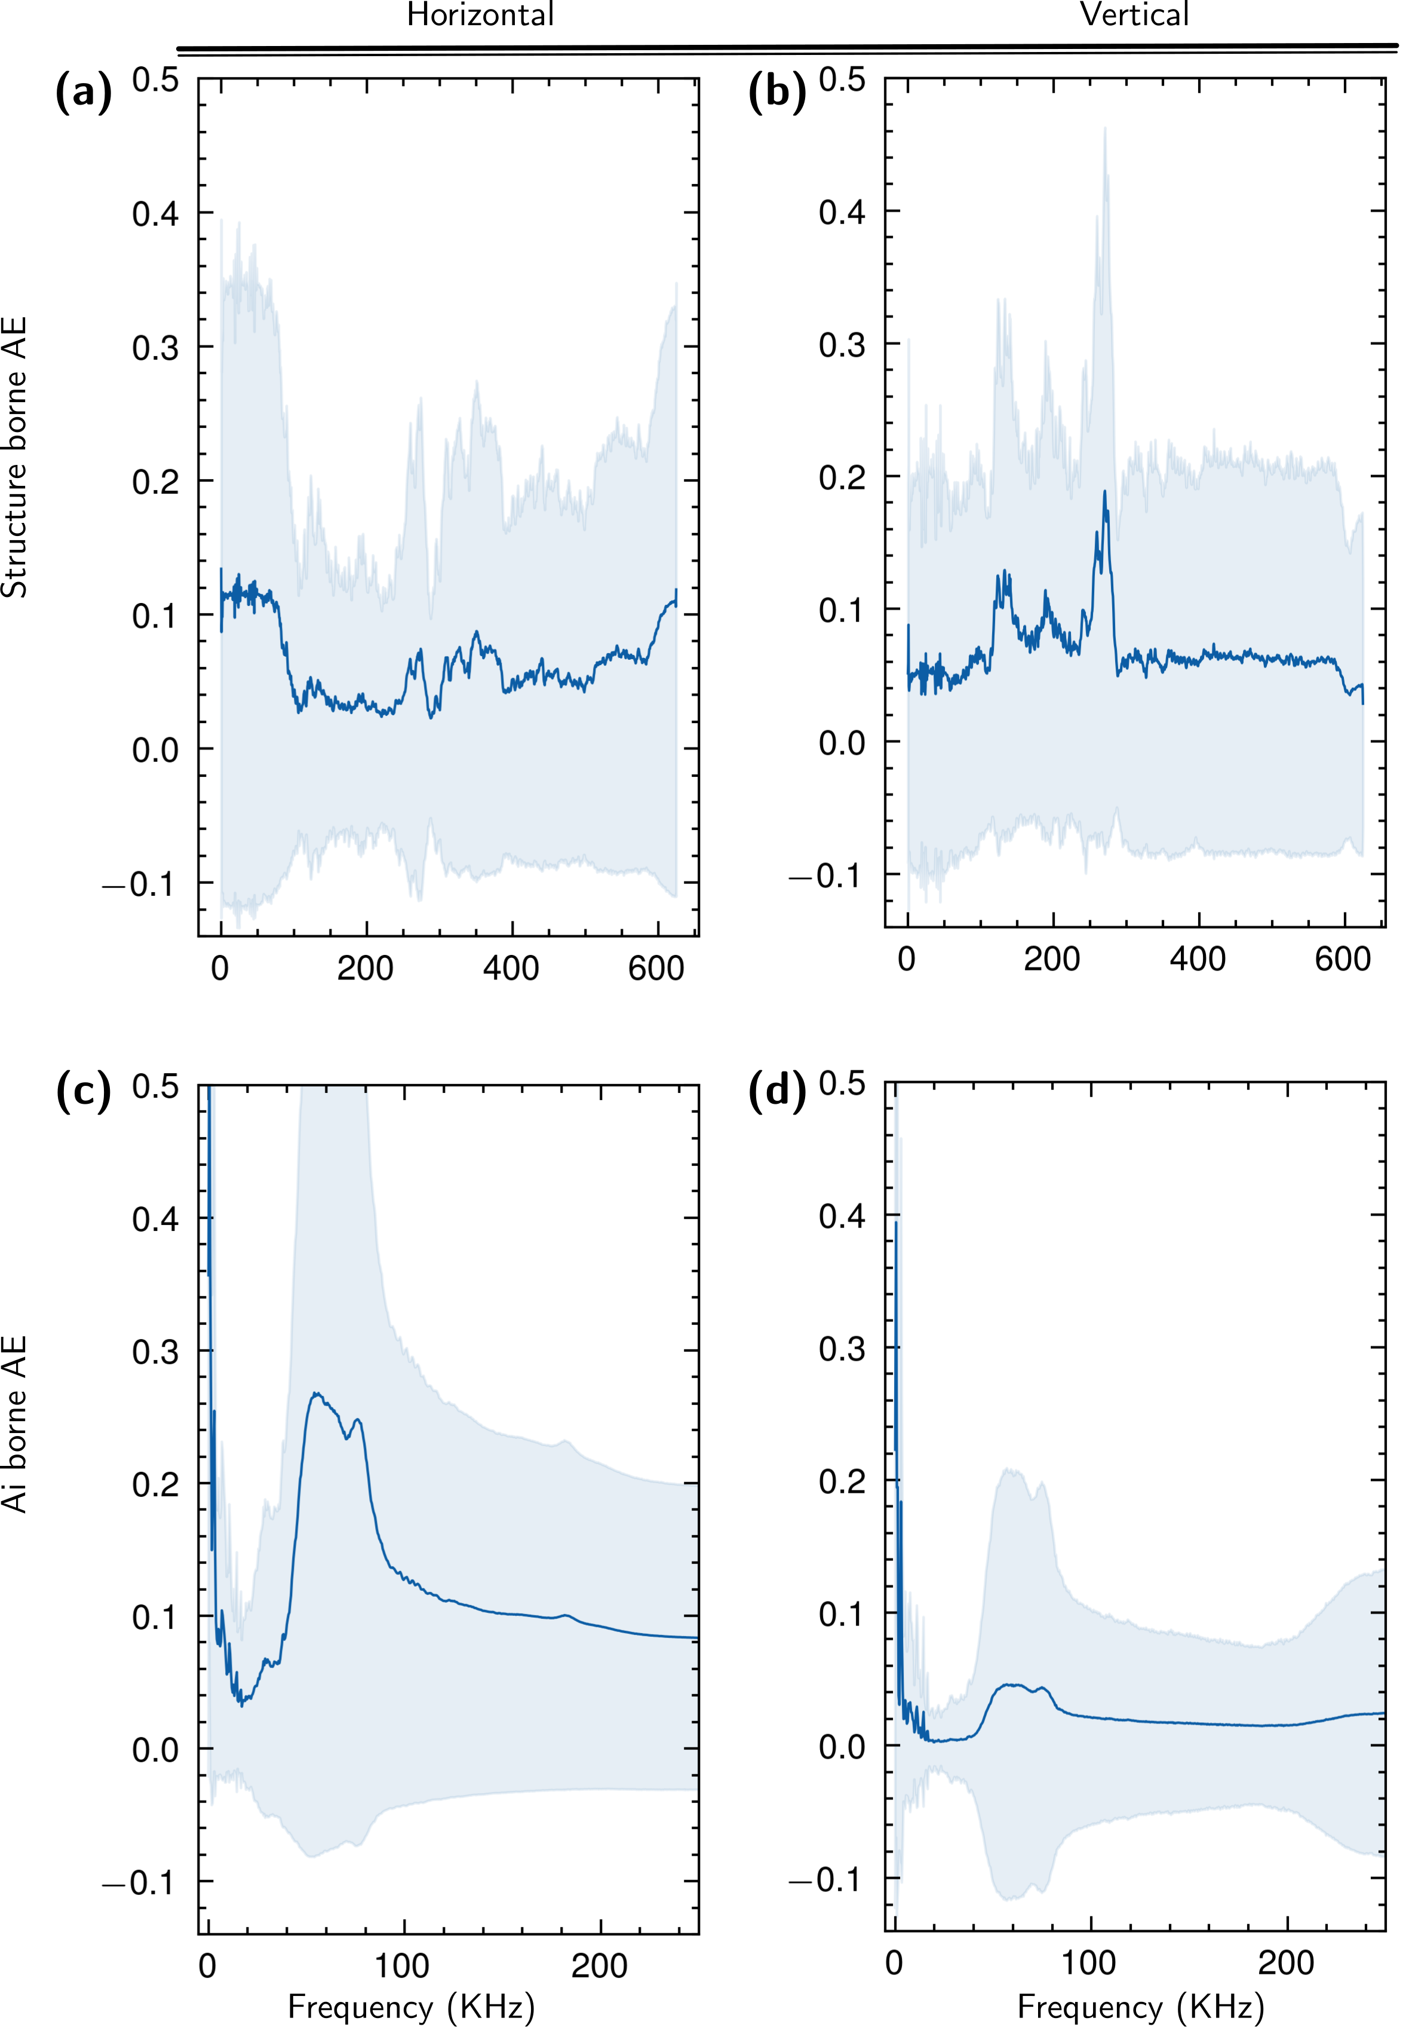
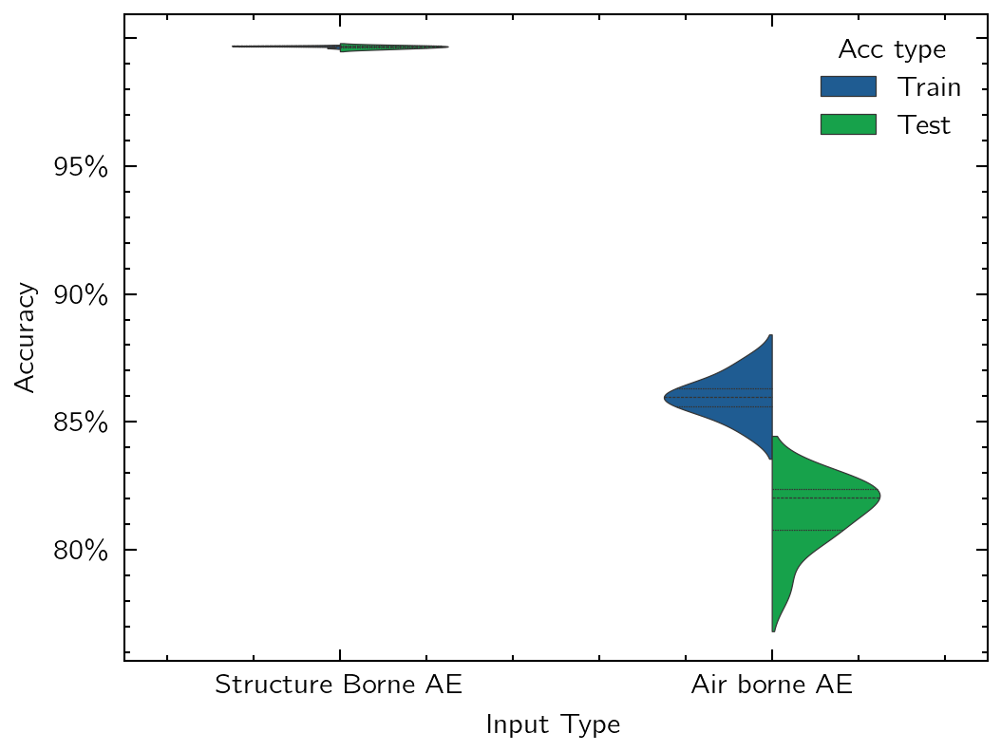
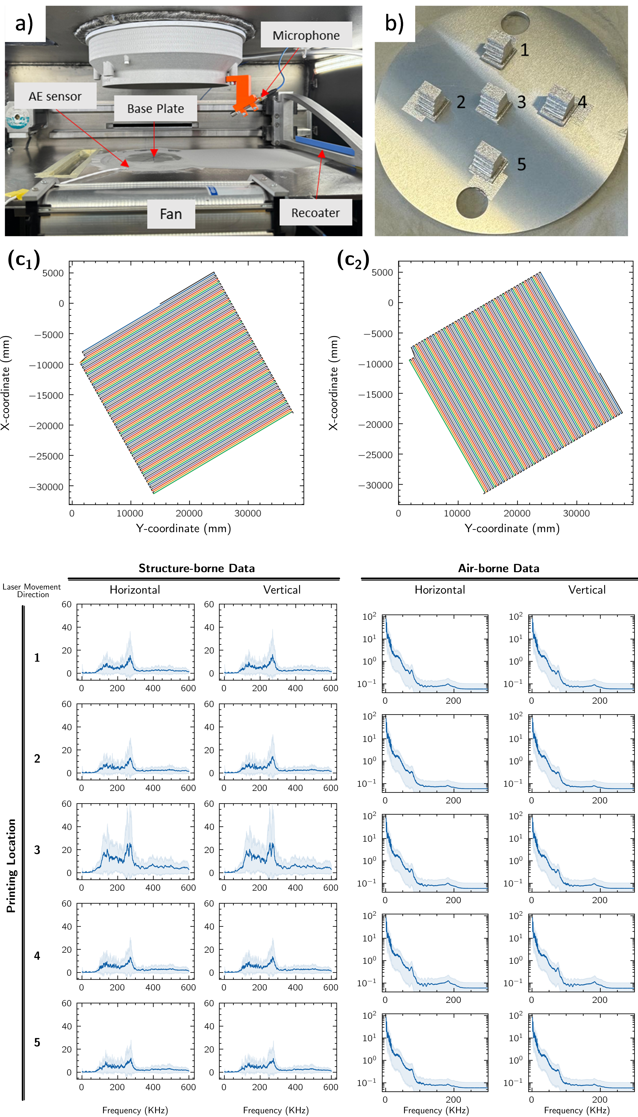
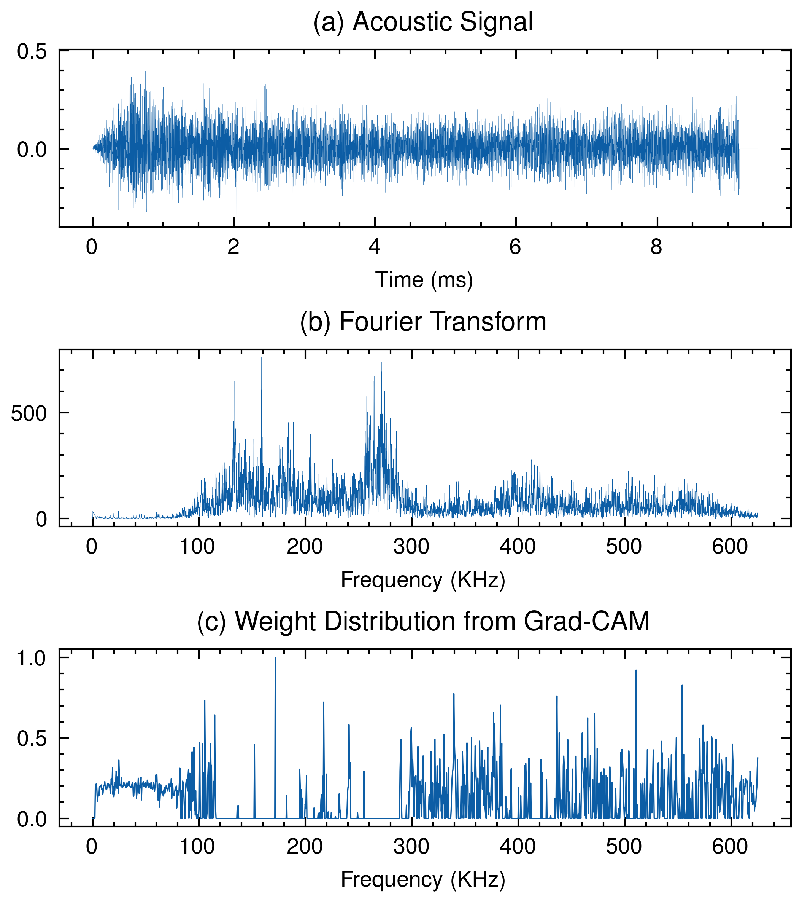
Data-driven Approach to Identify Distortion of Acoustic Signals by Process Contextual Information in LPBF Ming Wu, Shivam Shukla, Bey Vrancken, Mathias Verbeke, Peter Karsmakers
MuSIC
MPro
Quality Monitoring & Prediction of (De)Manufacturing Processes
Machinebuilders
Goal
Develop an approach to classify printed cubes based on acoustic signal characteristics while addressing context-related factors.
Identify invariant frequency features unaffected by variations in position and laser movement direction.
Approach
Quantitatively evaluate the influence of contextual factors (e.g., baseplate thickness, and laser movement direction) on frequency characteristics.
Use a CNN model for classification of printed cubes based on these contextual factors.
Employ Gradient-weighted Class Activation Mapping (Grad-CAM) to identify significant frequency bands for classification.
Extract invariant frequency features robust to variations in position and laser movement direction, a shown in Fig.4, the non area.
Results
The application of CNNs to Acoustic AE data enabled effective classification of contextual process conditions.
Structure-borne AE data demonstrated robust performance, achieving high classification accuracy (Fig. 2).
Airborne AE data successfully classified laser movement direction, with an accuracy of 84.3%, indicating its potential for monitoring certain process aspects (Fig.2).
Grad-CAM analysis revealed strong correlations between contextual process information and specific frequency bands within AE data (Fig.4).
(a)
Motivation
Acoustic Emission (AE) sensing shows promise for real-time monitoring, but its interpretation is hindered by factors like baseplate thickness and sensor orientation. Signal distortion due to wave propagation further complicates the analysis, making it challenging to isolate defect-specific information.
Enhance quality control by disentangling process-related acoustic signals from structural and environmental influences.
(b)
Fig. 2 Performance in predicting laser movement and printing position with (a) laser movement direction and (b) printing position
Fig .4 Grad-CAM weight visualizations from CNN models used to classify laser movement directions in frequency domains.
Key take-aways
AE data, particularly structure-borne signals, can reliably distinguish between different process conditions in LPBF.
Frequency bands identified by explainable AI provide valuable insights into the contextual factors affecting/distorting AE signals.
Future improvements could involve targeting these frequency bands with filtering and feature extraction to enhance defect detection and classification.
Fig .3 (a) AE signal in time-domain. (b) AE signal in frequency-domain. (c) The activation vector calculated by Grad-CAM which illustrates the relative importance of frequency bands in the CNN's classification decision.
Further reading
ref1: Wu et al. (2025), Data-Driven Approach to Identify Acoustic Emission Source Motion and Positioning Effects in Laser Powder Bed Fusion with Frequency Analysis, CIRP CMMO 2025 (submitted)
Fig. 1 Experimental setups and signal distortion with different printing direction and position
Ming Wu ming.wu1@kuleuven.be
Number of poster
157
For Publication

